Slide 1
Data Mining and Data Science Problems
Geospatial Data Seminar

Slide 2

Overview
Data Mining
Preprocessing
Feature selection
Model selection
Model evaluation
Geospatial Data Mining
Data Represenation
Ground removal
Plane fitting
(Co-)Registration
Segmentation
Classification
Object Detection

Slide 3
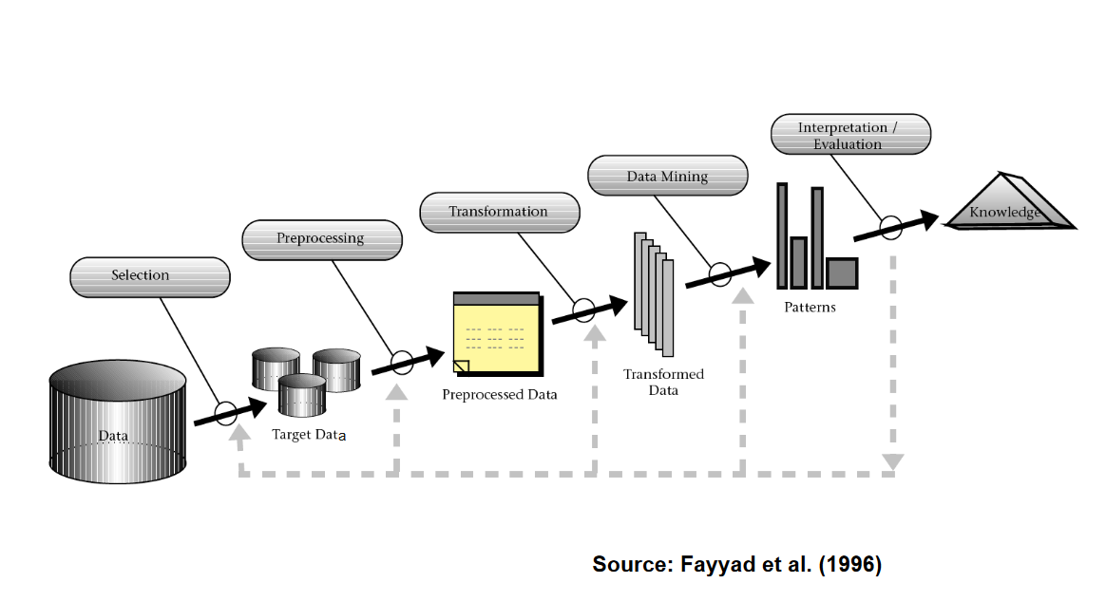
The Data Mining Process

Slide 4
Preprocessing
Cleaning and Preperation
Handing missing values
Normalizing data
Outliers

Slide 5
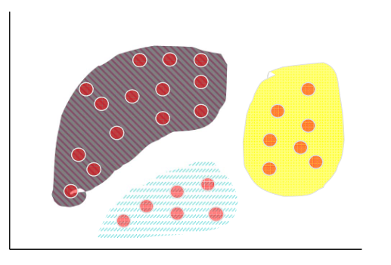
Feature Selection
Identification of
Relevant features
Important variables
Reduction of dimensionality
Improves efficency and accuracy
Clustering as a typical approach
https://www.uni-mannheim.de/media/Einrichtungen/dws/Files_Teaching/Data_Mining/Slides/DMI00-Intro-FSS2020.pdf

Slide 6
Feature Selection
Methods
Filter-based methods
Classifier-independent
Simple and efficient
Consideration of intrinsic properties of the given data
Wrapper-based methods
Embedded methods

Slide 7
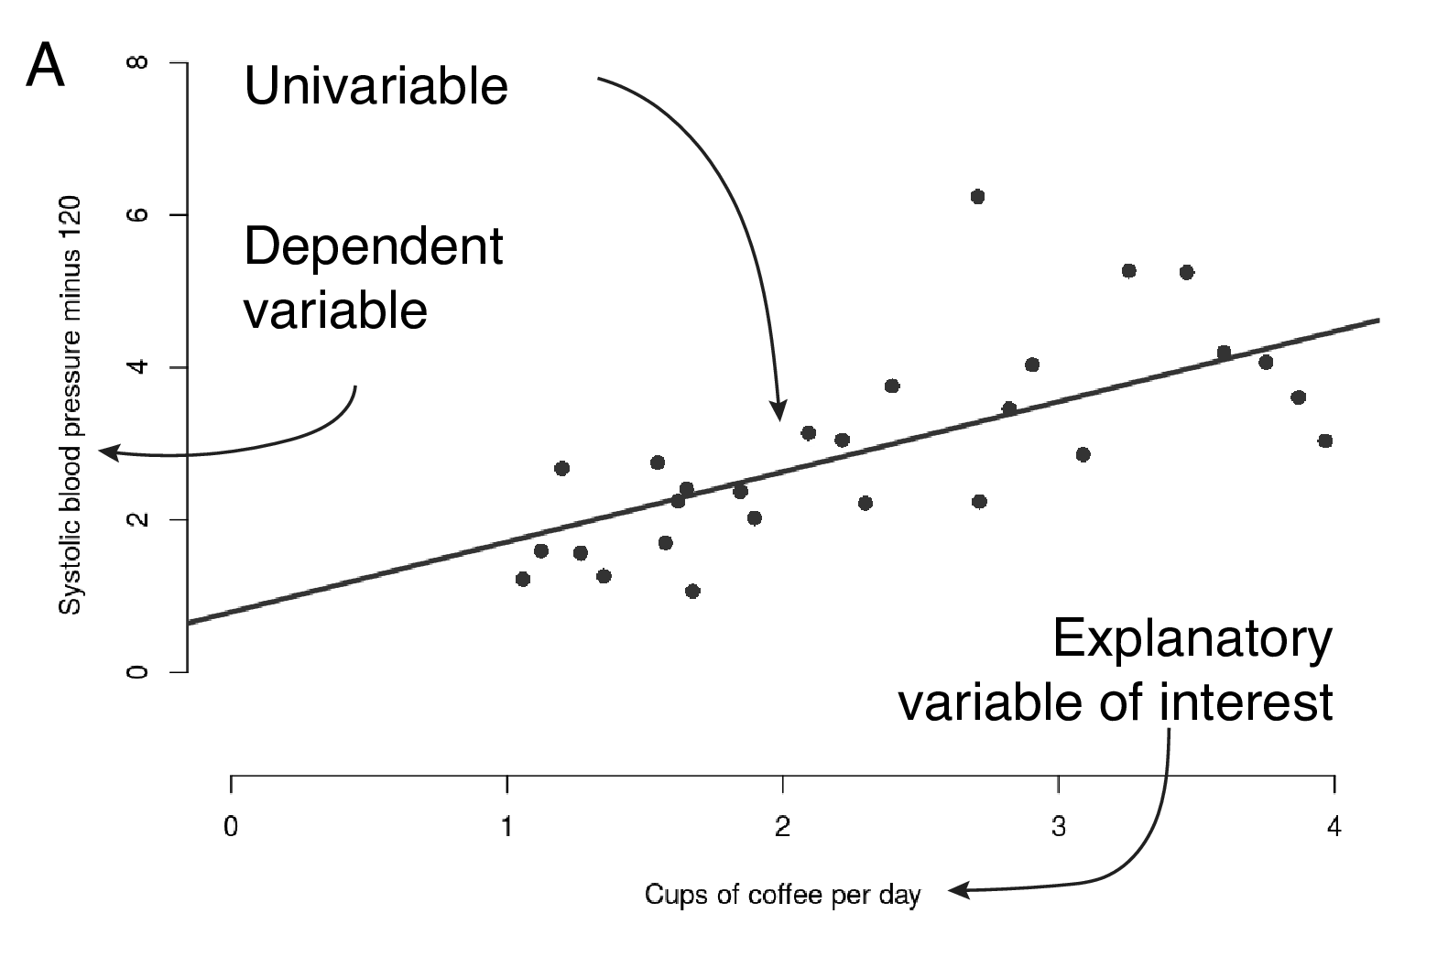
Model Selection
Different statistical models
Choose according to our problem
Examples
Classification Models
Decision Trees
Support Vector Machines
K-Nearest Neighbors
Regression Models
Linear Regression
Clustering Models
K-Means
https://argoshare.is.ed.ac.uk/healthyr_book/regression.html

Slide 8

Model Training

Slide 9
Model Evaluation
Accuracy
How often is the model correct
Precision
Measures quality of positive predicitons
Recall
how many correct predicitons are being made
F1-score
Harmonic mean of precision and recall
ROC-curves (Receiver Operating Characteristic Curves)
Area under the curve is to measure perfomance
1.0 is perfect, 0.5 is random guessing

Slide 10
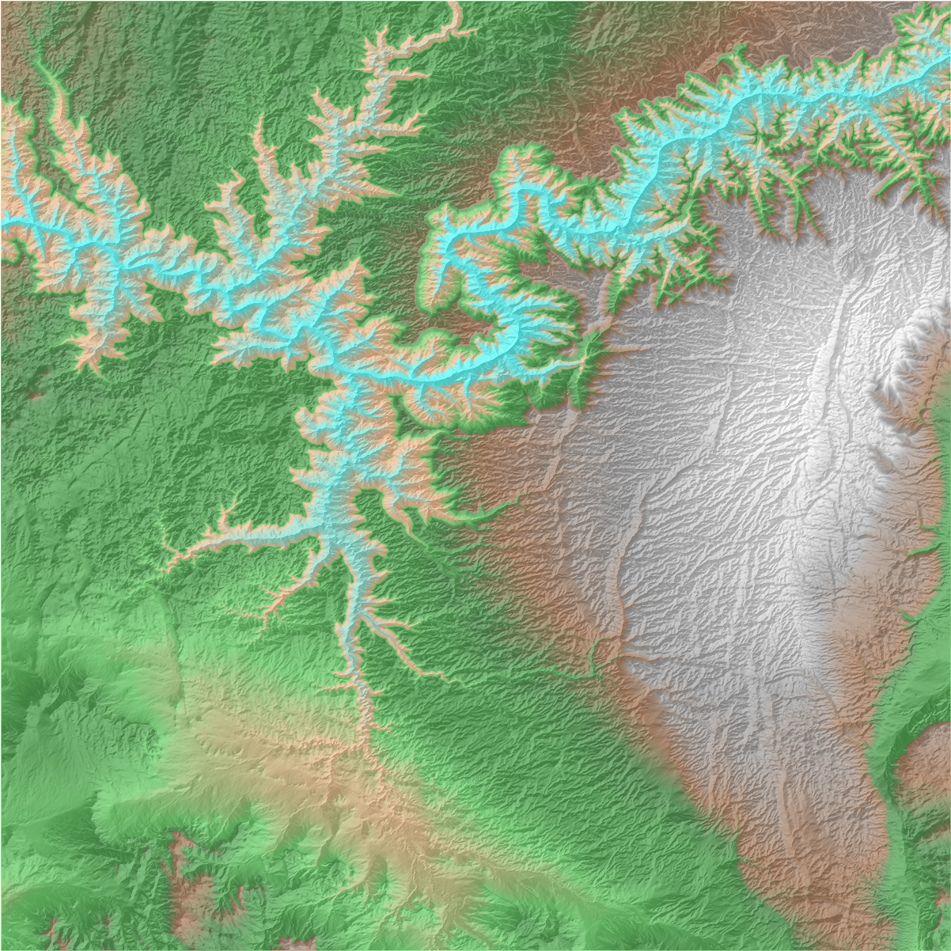
Geospatial Data analysis
How does the data mining workflow
change with geospatial data ?
https://github.com/DLR-terrabyte/eo-examples/blob/main/datasets/CopernicusDEM.ipynb

Slide 11
Data Represenations
Point-based
Voxel-based
Reduces memory needs thus more computatiuonally efficient
Frustum-based
Pillar-based
Excludes the z-coordinate
Projection-based
Reduce size for cost

Slide 12
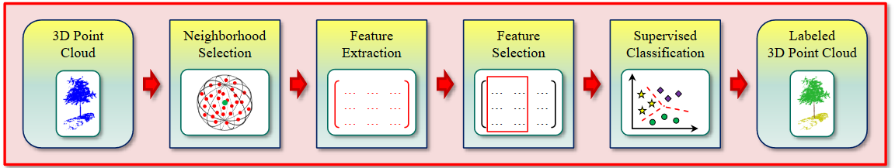
A typical workflow for classification

Slide 13
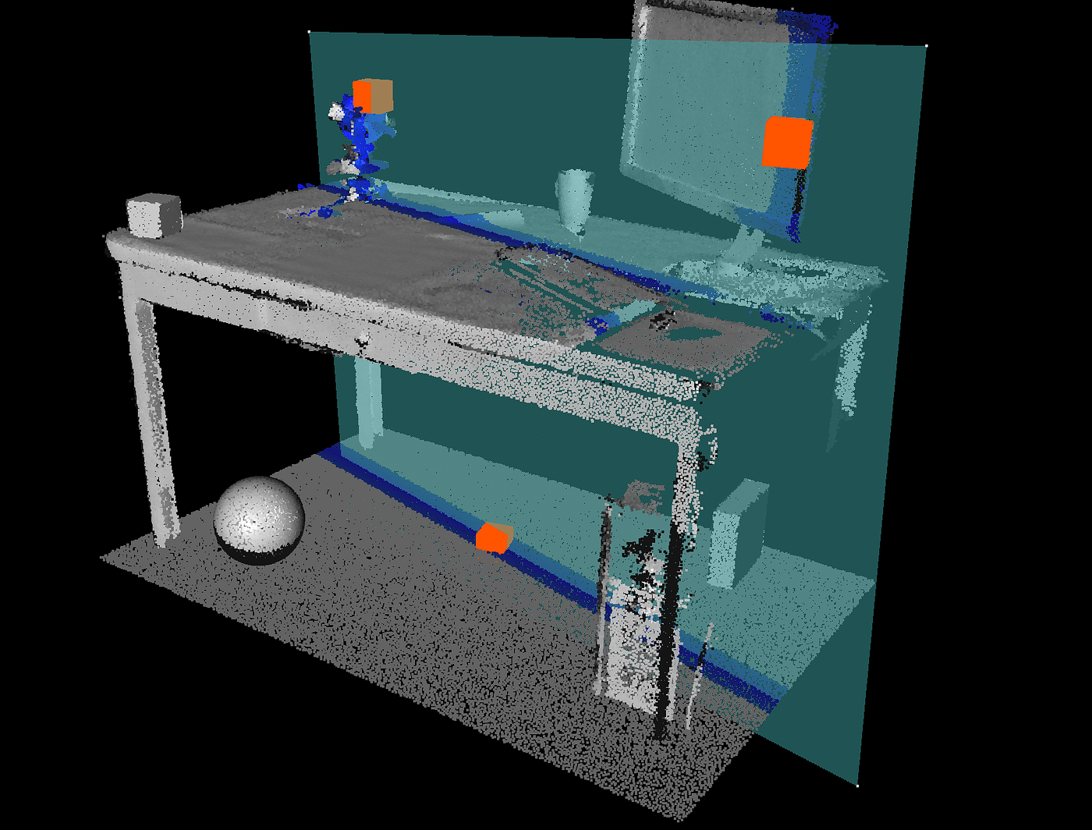
Plane Fitting
Fitting planar surfaces within point cloud data
Identification of flat surfaces
Walls
Floors
Tables
Algorithms
Least squares fitting
RANSAC
Fitted plane is prone to be influenced by noise
https://towardsdatascience.com/3d-model-fitting-for-point-clouds-with-ransac-and-python-2ab87d5fd363

Slide 14
Mitigate Noise in Plane fitting
Preprocessing
Noise filtering
Smoothing
Robust Algorithms (RANSAC)
Data Segmenatation
Clustering
Likely to belong to the same surface
Post-Processing
Removing iteratively outliers

Slide 15
Ground Removal
Typical preprocessing step
Non ground vs ground points can be used differently
Ground is a static point!
Halves the amount of points in a LiDAR scan
Various algorithms
Fast
Precise
Deal with uneven environments

Slide 16
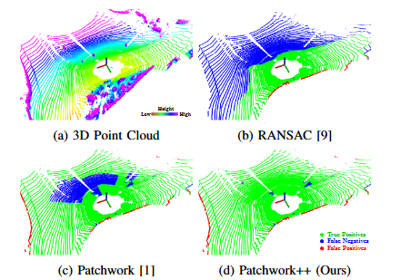
Ground Removal
Algorithms
Ground Plane Fitting (GPF)
Patchwork
Patchwork++
LineFit
RANSAC (random sample consensus)
CascadedSegmenation
https://arxiv.org/pdf/2207.11919

Slide 17
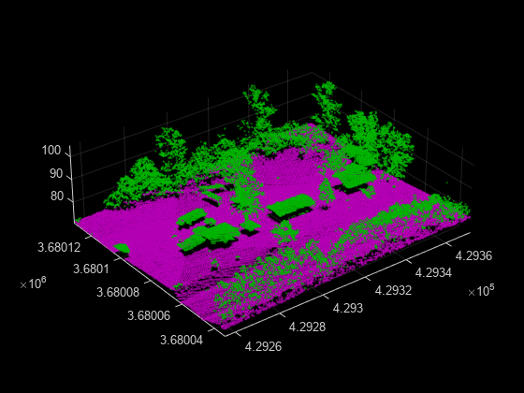
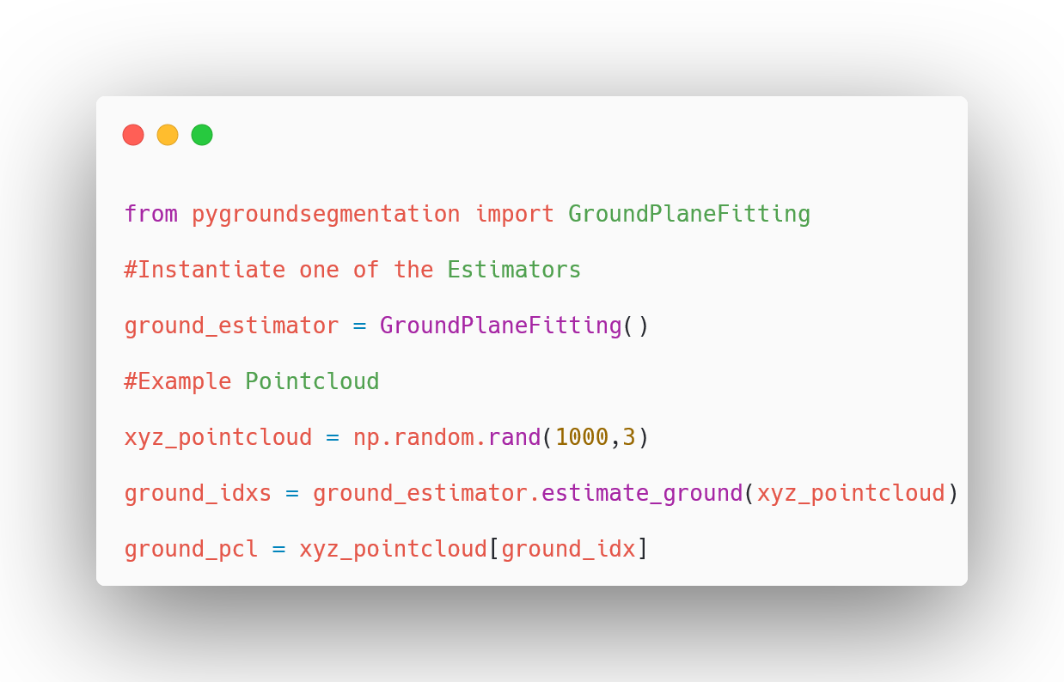
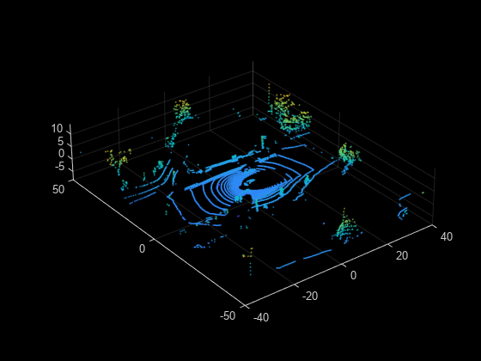
Ground Plane Fitting

Slide 18
(Co-)Registration
Alignment of pointcloud datasets to common cordinate system
Once alignment errors are below a threshhold, registration is complete
Techniques
Iterative Closest Point (ICP) algorithm
Generalized ICP
feature-based matching methods

Slide 19
Segmentation
Different segements in pcd (point cloud data)
Mutplitple homogenours regions or clusters with similar properties
Major approaches
Euclidean clustering
Region growing
Spatial neighborhood

Slide 20
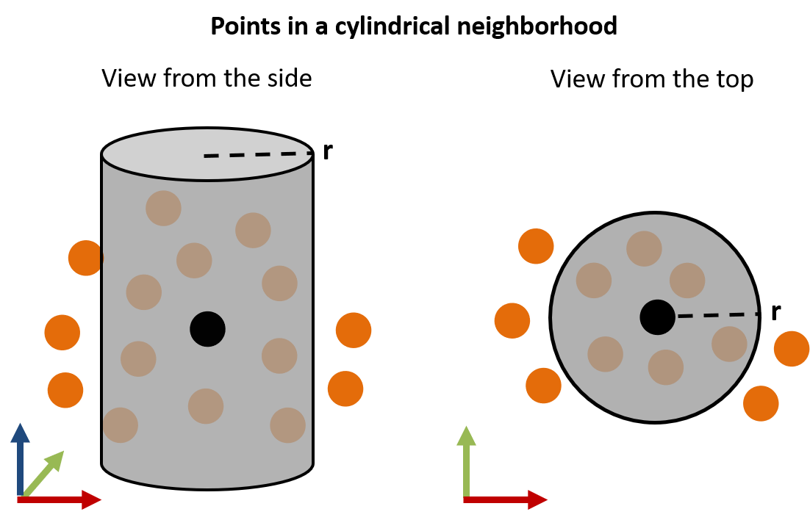
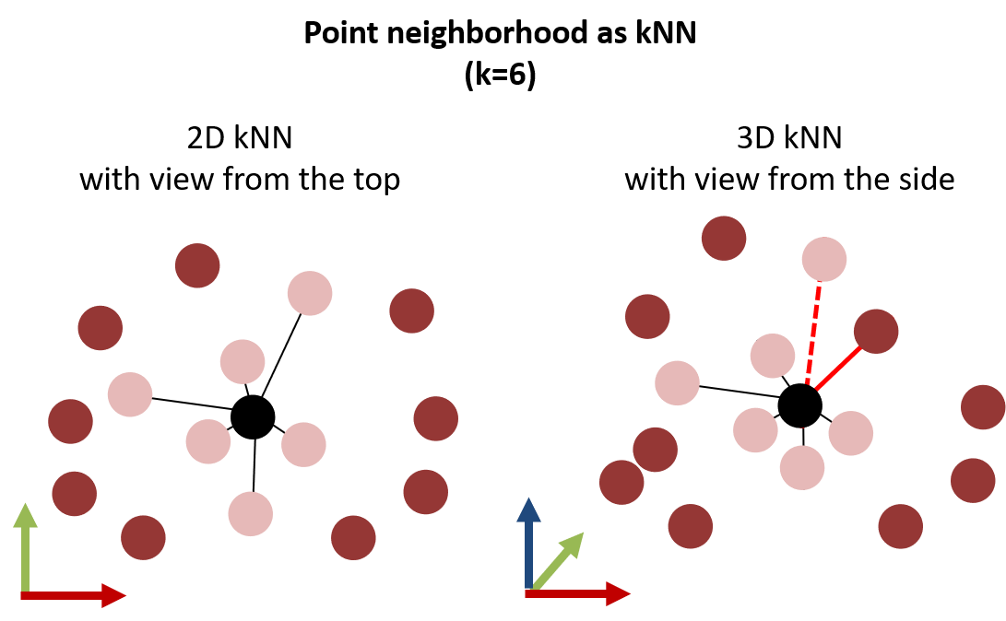
Spatial Neighborhood
https://3dgeo-heidelberg.github.io/etrainee/module3/01_pointcloud_principles/01_pointcloud_principles.html
https://3dgeo-heidelberg.github.io/etrainee/module3/01_pointcloud_principles/01_pointcloud_principles.html

Slide 21
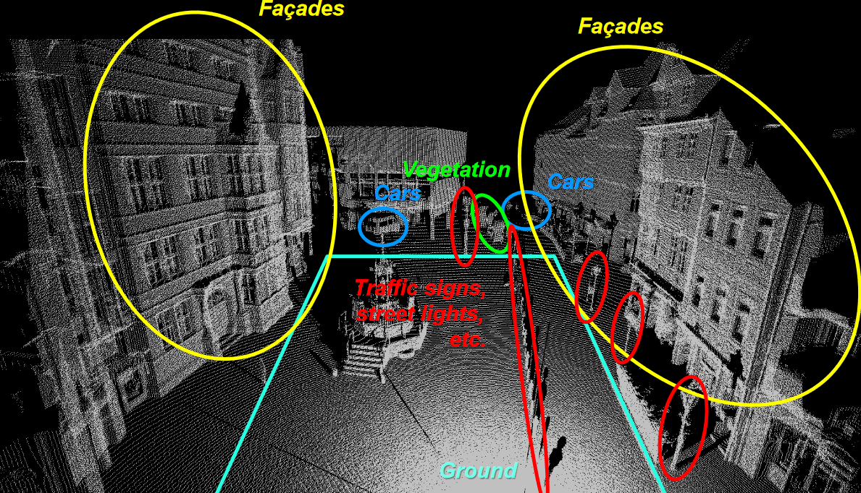
Classification

Slide 22
Classification
Assigning labels to points or segments in PCD
Various algorithms
Nearest Neighbor (NN) classifier
Decision Tree (DT)
Naïve Bayesian (NB) classifier
Linear Discriminant Analysis (LDA)
Support Vector Machine (SVM)
Random Forest (RF)

Slide 23
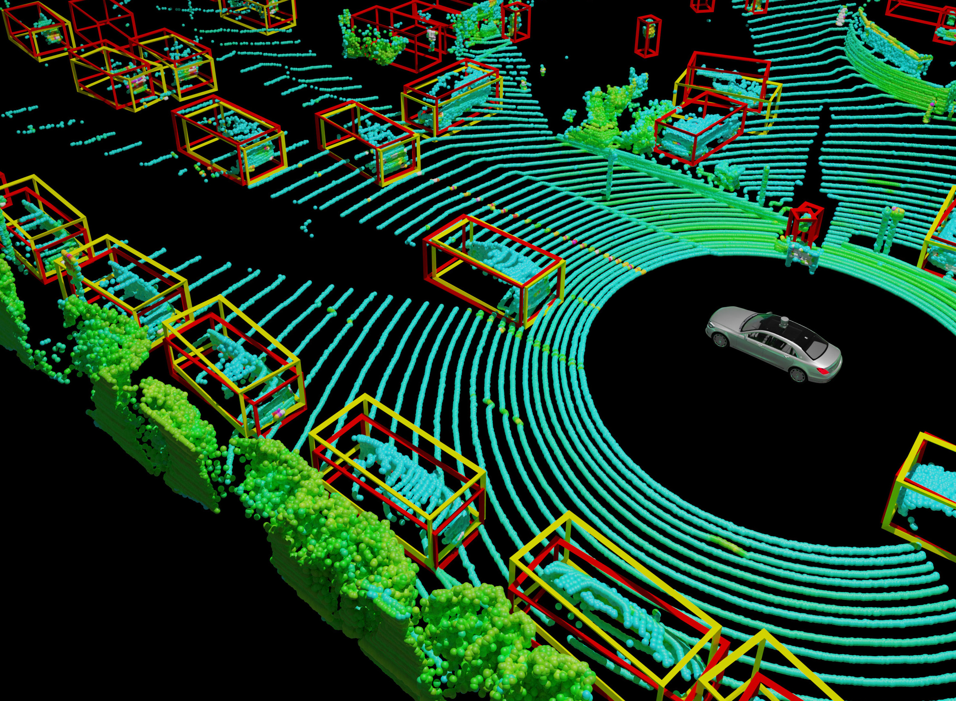
Object Detection
Essential part of the whole Process
https://arxiv.org/html/2403.07071v1

Slide 24
Outlook: Point-NET
Direct processing of raw point cloud data
Representation learning
Features describing the data, is learned from the data itself
Algorithm learns how to make it easy for classification and regression

Slide 25
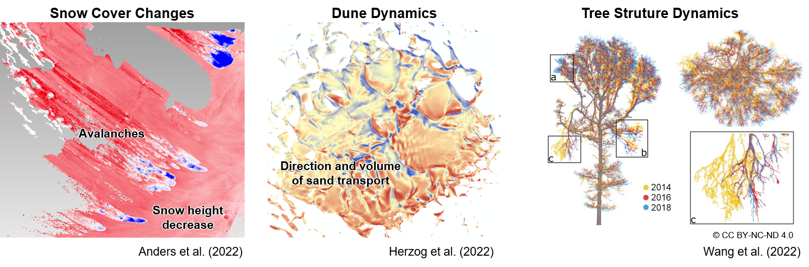
Questions?

